Slide 1
Business, Marketing, Entrepreneurship, Digital Marketing, and Econ Mrs. Schafer Class

Slide 2
The psychology of selling:
Brand Ambassadors
Marketing colors
Influencers
Product Placement

Slide 3
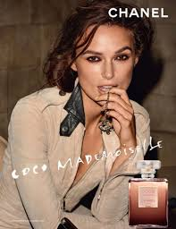
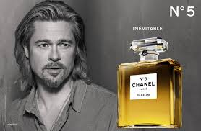
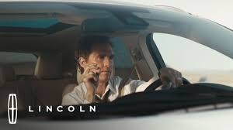
Brand Ambassador
Who is it?
a person, especially a celebrity, who is paid to endorse or promote a particular company's products or services.
What can you expect from a brand ambassador?
positively representing the brand in a myriad of settings though action and demeanor.
Cooperating and assisting in content creation (blogs, posts, reviews, product promotion)
Utilizing word of mouth marketing to help naturally generate brand awareness.
Promoting the brand on social media platforms.

Slide 4
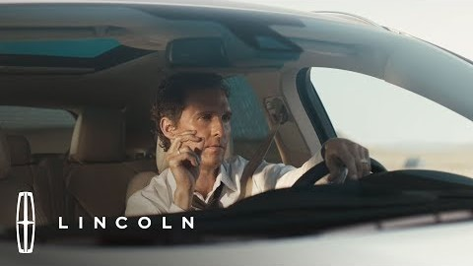
Brand Ambassador
Notes:
https://www.youtube.com/watch?v=8QEAA94FjHc

Slide 5

Brand Ambassadors Do More Promotion and Affect Sales
Notes:
https://www.youtube.com/watch?v=RzCh6eoLEgY

Slide 6
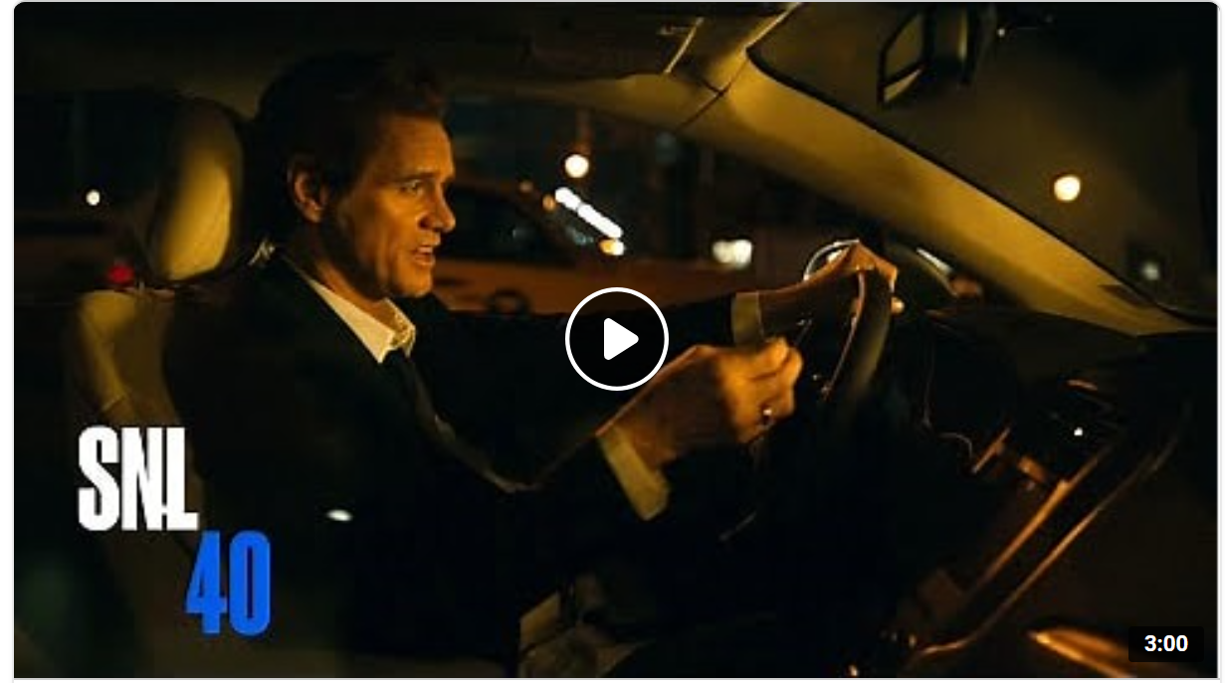
Parodies Help the Brand!
Notes:
lincoln towncar parody commercials jim carrey - Search (bing.com)

Slide 7

Brad Pitt – Chanel Brand Ambassador
Notes:
https://www.youtube.com/watch?v=mGs4CjeJiJQ

Slide 8
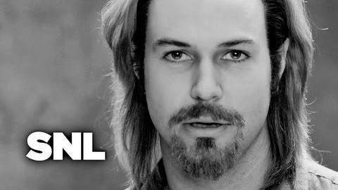
Brad Pitt – Chanel Brand Ambassador Parody
Notes:
snl chanel parody brad pitt - Google Search

Slide 9
Use of colors in marketing
The Psychology of Color

Slide 10
Lesson Objective
To learn how colors play a
role in determining what we buy.

Slide 11
COLORS
Our brains are hard-wired to notice color.
Although a person’s opinion about colors can be personal and unique, certain colors invoke specific attitudes and feelings in all of us.
Color can even influence us to buy things.

Slide 12
COLORS
HOW DOES COLOR AFFECT YOU?
Let’s find out!
Take the quiz found here:
http://www.factmonster.com/quizzes/psychcolors/1.html

Slide 13
The use of specific colors in marketing
The following slides will explain how different colors can make a person feel about specific products.

Slide 14
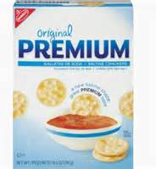
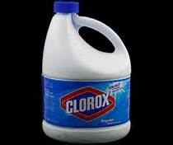
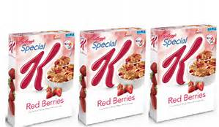
WHITE
White can be associated with innocence, purity, peace and contentment.
It can also be considered clean and sterile.
White can have a calming, stabilizing influence on people.
Here are examples of popular brand with white packages:
Notes:
(2) The Psychology Of Color In Marketing And Branding – YouTube

Slide 15
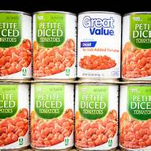
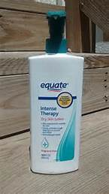
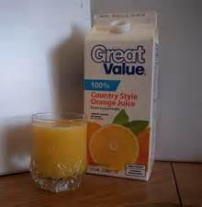
WHITE
Examples:
HOWEVER, white can also make people think of GENERIC BRANDS, which can also make people think the item is of a lower quality.

Slide 16
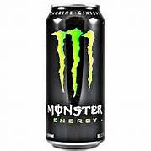
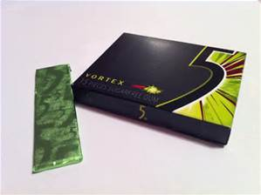
BLACK
Black is the ultimate power color - it suggests strength, potency, authority, boldness, seriousness, stability and elegance.
It’s distinguished and classic, great for creating drama.
However, black has more weight than other colors. Too much can seem dark and dreary.
Examples:

Slide 17
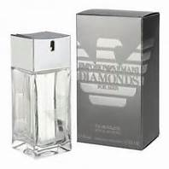
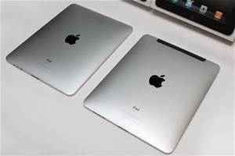
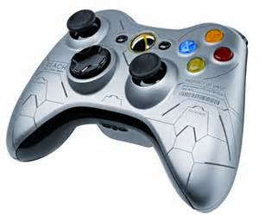
GRAY OR SILVER
Gray can be associated with conservative qualities and considered traditional.
Business-wise, it symbolizes high tech and suggests authority, practicality, and creativity.
Examples:

Slide 18
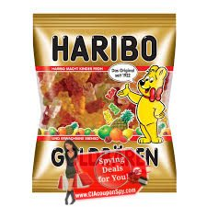
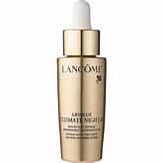
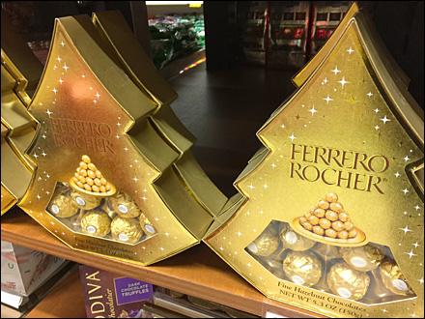
GOLD
Gold suggests wealth and luxury
Gold products want to convey the message that they are very classy.
They also want to give the message that they are high quality.
Examples:

Slide 19
BLUE
Blue is the favorite color of many businesses.
Blue suggests wholesomeness and fiscal responsibility. It can also inspire confidence.
Blue is the most popular color and second most powerful color.
Darker shades are authoritative.
Dark and bright blues represent trust, security, faithfulness and dignity.
Paler shades can imply freshness and cleanliness, although they can imply weakness too.

Slide 20

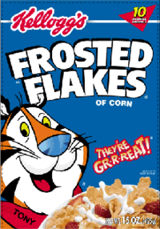
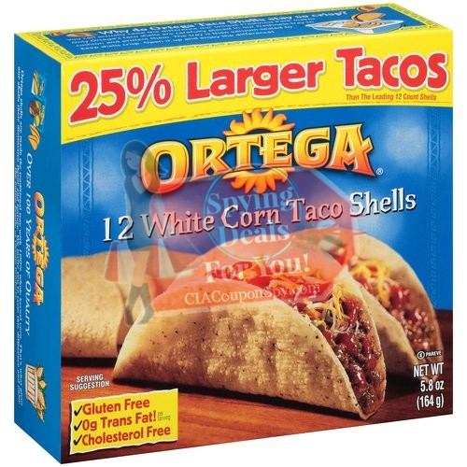
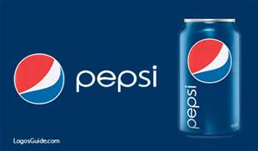
BLUE
Popular brands marketed in blue include:

Slide 21
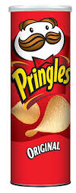
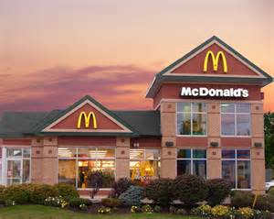
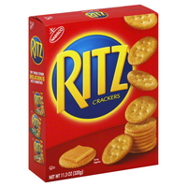
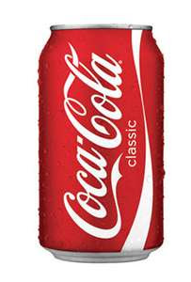
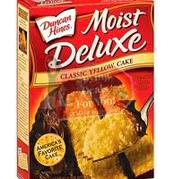
RED
Red has been known to stimulate the appetite.
Popular examples:
Red commands attention, alerts us and creates a sense of urgency. It’s considered the most passionate of all colors.
Red symbolizes heat, fire, blood, love, warmth, power, excitement, energy, strength, passion, vitality, risk, danger and aggressiveness.

Slide 22
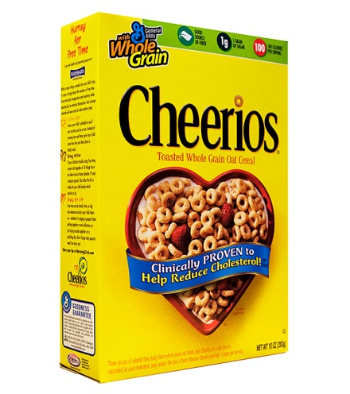
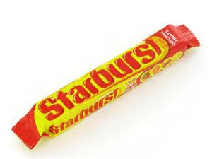
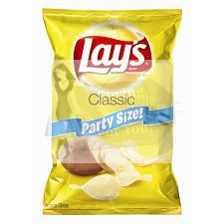
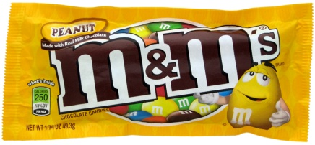
YELLOW
Yellow is the sunshine color. Yellow represents a warning, but it can also bring happiness and warmth.
The most preferred yellows are the creamy and warm ones. Bright yellow can be irritable to the eye in large quantities.
Yellow speeds metabolism. Many snack food packages are yellow. Examples include:
O

Slide 23
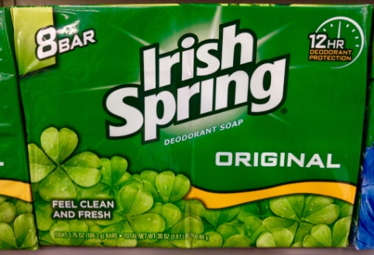
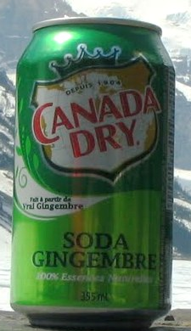
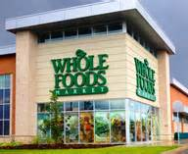
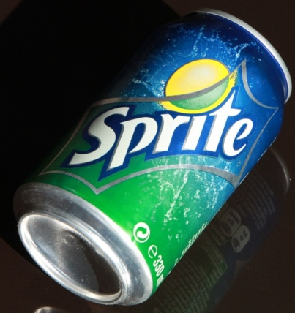
GREEN
People associate green with the color of money, as well as nature.
Green suggests life, freedom, healing and tranquility.
Green can also represent jealousy. Businesses use it to communicate status and wealth.
Olive greens are associated with health and freshness — a good choice for environmental concerns.
Green is a calming, refreshing color that is very easy on the eyes.
Popular green examples:

Slide 24
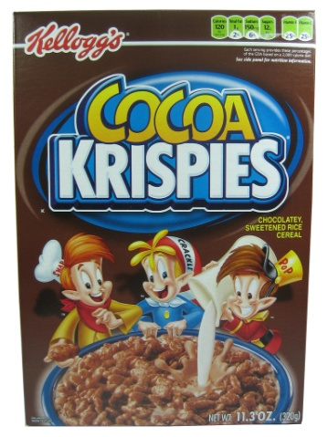
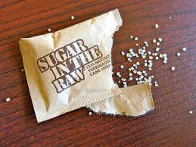
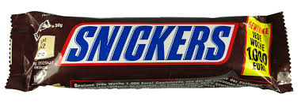
BROWN
Brown is associated with nature and the earth. Brown and shades of cream are associated with warmth and coziness.
Brown suggests richness, politeness, helpfulness and effectiveness. It is solid, credible, mature and reliable. Light brown implies genuineness.
MANY brown packages are for chocolate-flavored items!

Slide 25
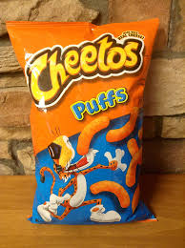
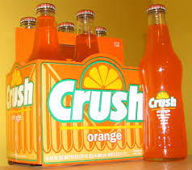
ORANGE
Orange is associated with vibrancy and the tropics, as well as warmth and contentment.
Orange can instill a sense of fun and excitement.
It can make an expensive product seem more affordable.
Like brown, many orange packages are simply orange to convey the flavoring of what’s inside:
Interestingly – when surveyed, both men and women report orange as their LEAST favorite color!

Slide 26
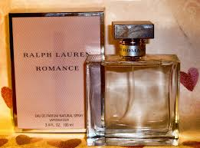
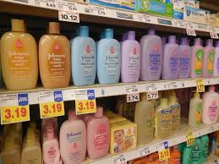
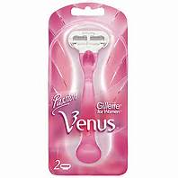
PINK
Pink represents gentleness, romance, well being and innocence.

Slide 27
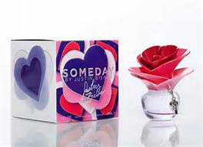
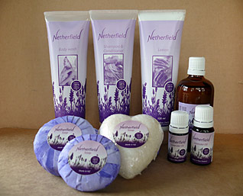
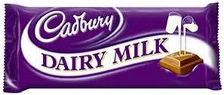
purple
Purple represents royalty and luxury.
Purple can suggest spirituality and sophistication.
In darker shades, purple is considered a wealthy color.
In paler shades, such as lavender, it’s romantic.
Examples:

Slide 28
COLORS, cont.
Use this knowledge to your advantage!
The primary color of your packaging should express the feeling(s) that you want to be associated with your product.

Slide 29
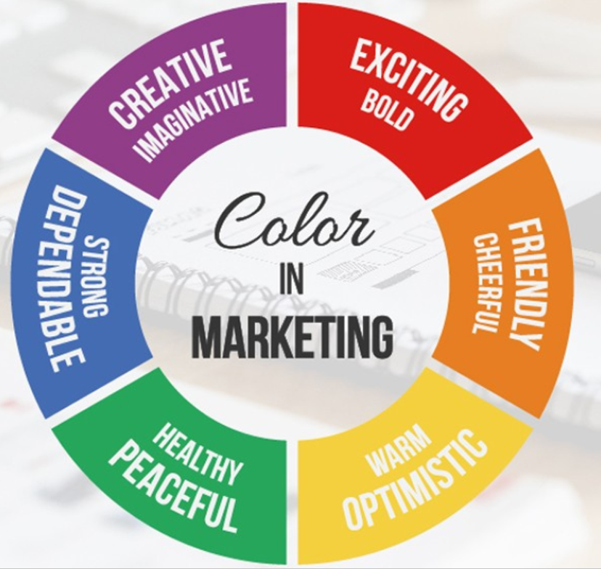
Color Meanings in Marketing

Slide 30
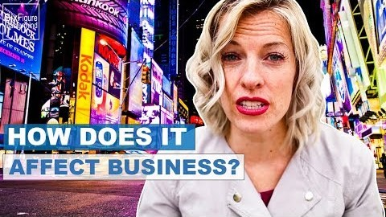
The Psychology of Color
Notes:
https://www.youtube.com/watch?v=j7z7uhxLxrY
Psychology of color questions:
What kind of shapes are used with orange logos?
Which color appears closer to you than other colors?
Which color is for the “creatives”?
Why would a petroleum company use green?
Which color has less company names actually written into the logo?
Don’t use more than what number of colors in your logo?
Why would you use multiple colors in your logo?

Slide 31
Influencers

Slide 32
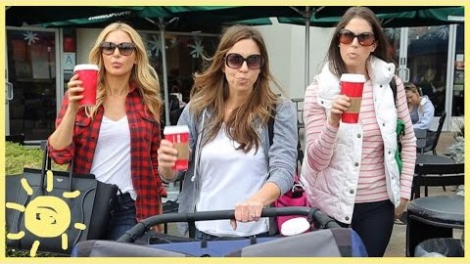
Influencers are different than brand ambassadors! What are they promoting here?
Notes:
https://www.youtube.com/watch?v=6FrBS2pPcak

Slide 33

Influencers – What are they selling here?
Notes:
https://www.youtube.com/watch?v=OKD2kzXSX-k

Slide 34
Product Placement

Slide 35
Getting into your subconscious works better than outright advertising to you
You will never be able to watch tv shows or movie the same way again
Who’s paying the movie studio?
Everything is marketing to you!
Amount of time product is shown onscreen means more money the company is paying the movie studio
Who is using it counts (villians not allowed to use Apple products)
If logo grayed out, that means the company didn’t allow use of it/didn’t pay the movie to show it
Lots of generic products (especially in grocery store scenes)

Slide 36

Product Placement – amount of screen time matters
Notes:
https://www.youtube.com/watch?v=0h0TKE88nvc
https://www.youtube.com/watch?v=ZqP8G4L6_Gw – Top Gun

Slide 37

Who watches Stranger Things? How many product placements did you notice?
Notes:
https://www.youtube.com/watch?v=w31dKJMdqh4

Slide 38
Parody of Product Placement
Truman Show advertisements (youtube.com)
The Truman Show was a movie about a man whose whole life was a tv show, but he didn’t know it.

